Slide 1


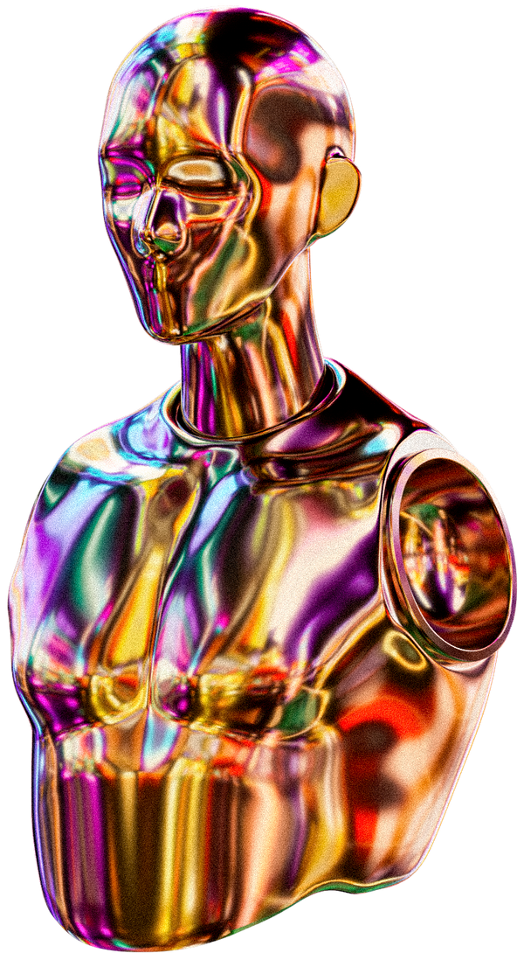
Home
About
Contact
Go Game with AI and GUI using Python
🎮✨📊
A detailed report on the design, algorithms, and implementation
Presented by:
Ahmed Gamal

Slide 2
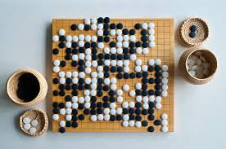
Timmerman Industries
Home
About
Contact
Project Overview
Objective:
To develop a functional Go game with AI and a graphical user interface (GUI) using Python. 🧩🤖📐
Key Features:
Interactive gameplay with AI support.
Multiple board sizes: 9x9, 13x13, and 19x19.
Save and load game functionality.
User-friendly GUI built with Tkinter.

Slide 3
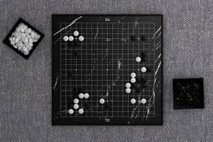

Timmerman Industries
Code Overview
Programming Language: Python 🐍💻📚
Main Components:
Game Logic: Handles rules, scoring, and move validation.
AI Implementation: Includes Minimax with Alpha-Beta Pruning.
GUI: Provides an interactive interface using Tkinter.
Utilities: Handles board states, game saving/loading, and configurations.
Libraries Used:
tkinter: GUI development.
numpy: Board state management.
json: Saving/loading game states.

Slide 4
Game Rules (Brief)
Timmerman Industries
Objective: Surround more territory and capture more stones than your opponent. 🕹️⚡🏆
Key Rules:
Move Validation: Players alternate placing stones on the board at intersections.
Captures: A group of stones with no liberties (empty spaces) is removed.
Passing and Endgame: Players may pass their turn. The game ends when both players pass consecutively.
Scoring: Points are determined by territory control and captured stones.

Slide 5

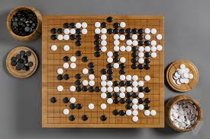
GUI Design
Built with Tkinter 🖥️🎨🔧
Timmerman Industries
Main Features:
Interactive Board: Users click to place stones.
Menu Options:
Start a new game
Change board size
Save/load game states
Choose AI difficulty
Real-Time Updates:
Display current scores.
Highlight valid moves.
Endgame Interface: Displays final scores and declares the winner.

Slide 6

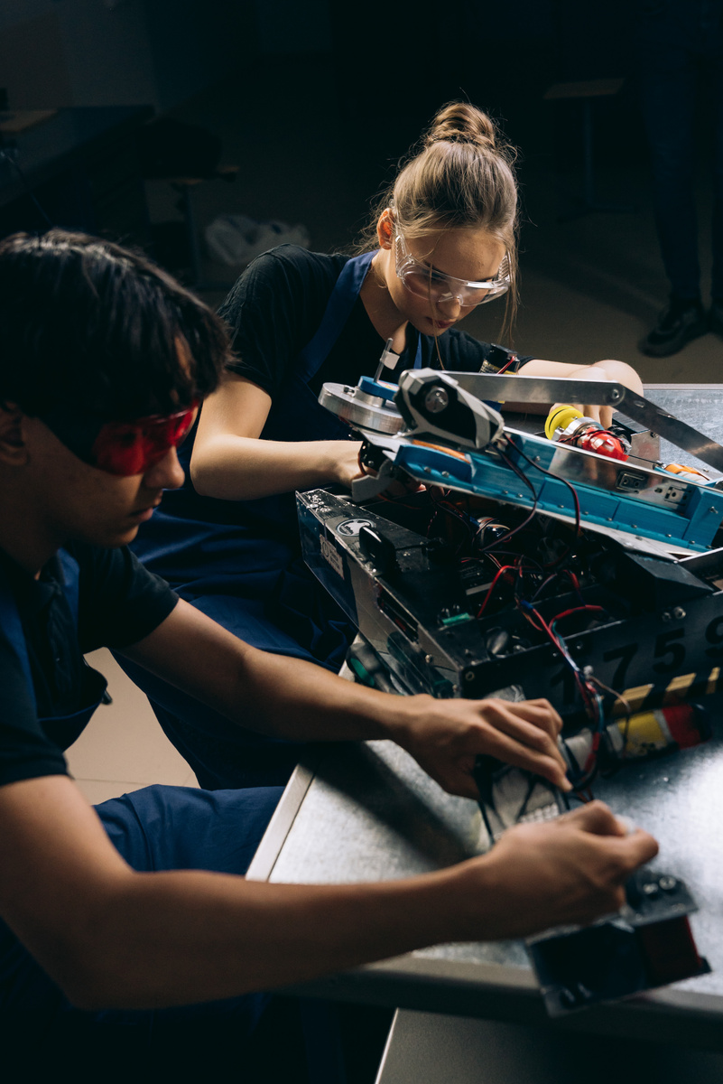



Timmerman Industries
Home
About
Contact
Algorithms Used
1. Minimax Algorithm 🌌🔢🎯
2. Alpha-Beta Pruning
Explores all possibMain Features:
Interactive Board: Users click to place stones.
Menu Options:
Start a new game
Change board size
Save/load game states
Choose AI difficulty
Real-Time Updates:
Display current scores.
Highlight valid moves.
Endgame Interface: Displays final scores and declares the winner.
Optimizes Minimax by pruning branches that won’t affect the outcome.
Reduces computational complexity.
3. Heuristic Evaluation
Calculates the value of board states based on:
Territory controlled.
Stones captured.
Potential moves.

Slide 7
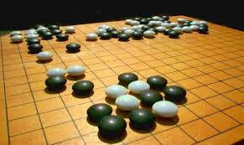
Timmerman Industries
Home
About
Contact
AI Implementation
AI Decision-Making Process: 🤖🧠🛠️
Evaluate current board state.
Simulate possible moves.
Score each move using heuristics.
Choose the move with the highest score.
Difficulty Levels:
Easy: Random valid moves.
Medium: Shallow Minimax with heuristics.
Hard: Minimax with Alpha-Beta Pruning at greater depth.

Slide 8
Timmerman Industries
Board State Management
Representation:
The board is represented as a 2D array using numpy. 📊🧩🗂️
States Tracked:
Current Board: Tracks stone placement.
Previous States: For move validation and undo functionality.
Captured Stones: To update scores dynamically.
Saving/Loading:
States are serialized into JSON format for storage.

Slide 9

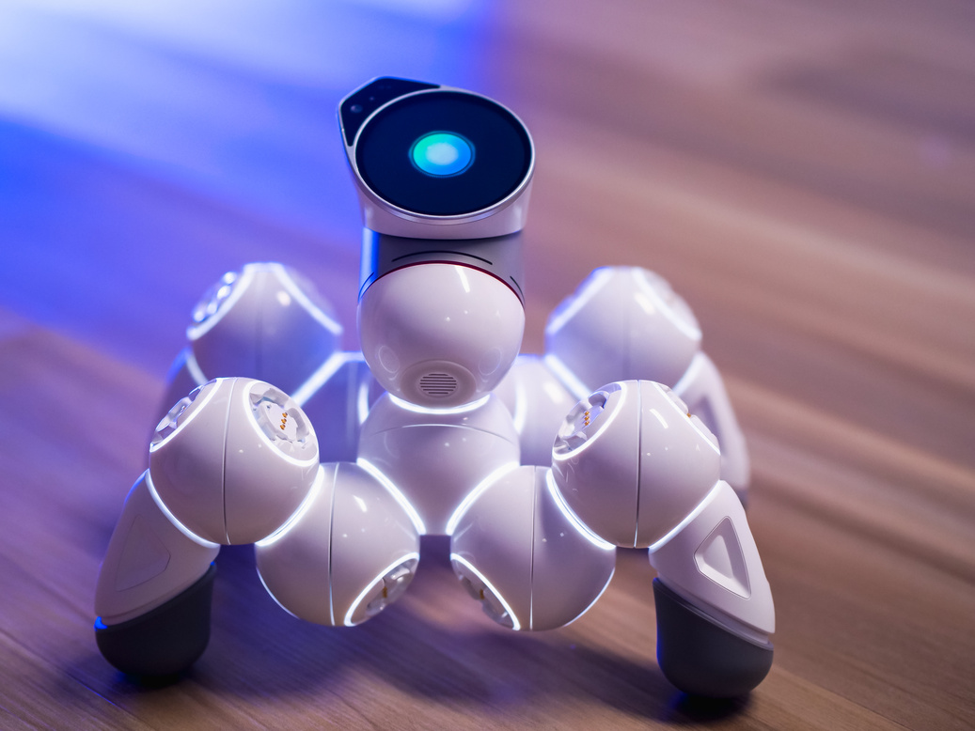
Timmerman Industries
Home
About
Contact
Challenges and Solutions
Challenges: 🧗‍♂️⚙️🔍
High computational cost of Minimax on larger boards.
Handling edge cases in move validation and scoring.
Making the GUI responsive and user-friendly.
Solutions:
Optimizations: Alpha-Beta Pruning to improve AI efficiency.
Testing: Extensive testing with different scenarios.
GUI Refinements: Clear feedback to users for invalid moves.

Slide 10
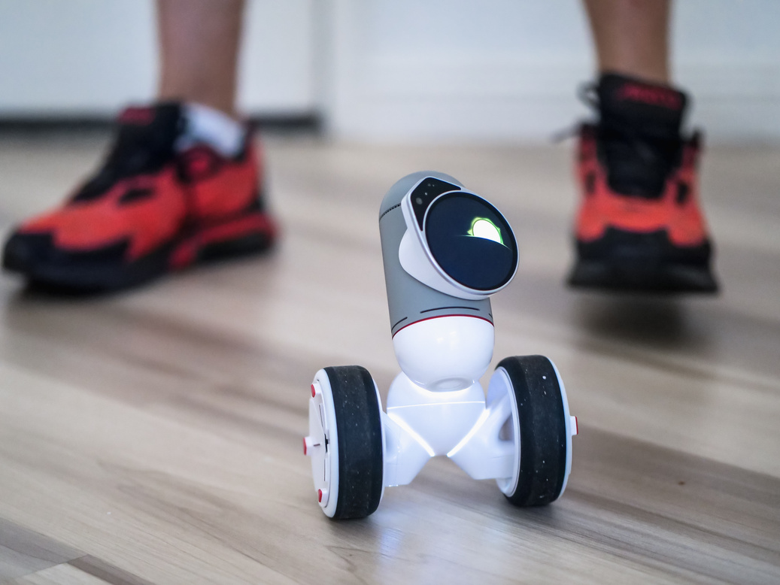
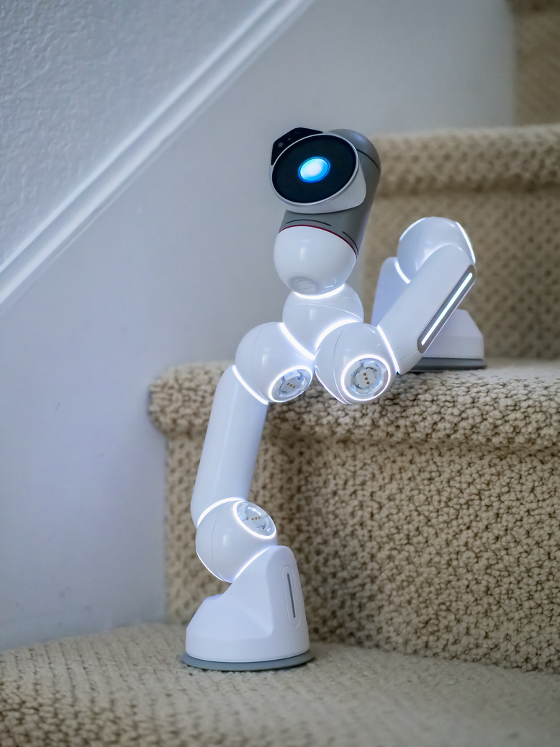
Timmerman Industries
Home
About
Contact
Future Improvements
Proposed Enhancements: 🚀🌟🔮
Advanced AI: Implement Monte Carlo Tree Search (MCTS) for better performance.
Online Multiplayer: Add support for remote gameplay.
Enhanced Graphics: Improve visual appeal of the GUI.
Dynamic Difficulty: AI adapts to player skill level.
01
Enhanced Graphics: Improve visual appeal of the GUI.
02
Dynamic Difficulty: AI adapts to player skill level.
03

Slide 11
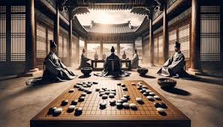
Timmerman Industries
Home
About
Contact
Key Learnings
Combining game development with AI requires balancing performance and complexity. 📝💡📘
Tkinter provides a robust framework for simple GUIs but may need additional libraries for advanced designs.
Heuristic evaluation and optimization are critical for AI efficiency in complex games.

Slide 12
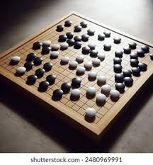
Timmerman Industries
Home
About
Contact
Conclusion
Summary: 🏁✨🤝
Developed a functional Go game with AI support.
Implemented GUI for an interactive experience.
Optimized AI using Minimax and Alpha-Beta Pruning.
Closing Note: The project highlights the intersection of game development, AI, and GUI design, with room for further enhancements.

Slide 13
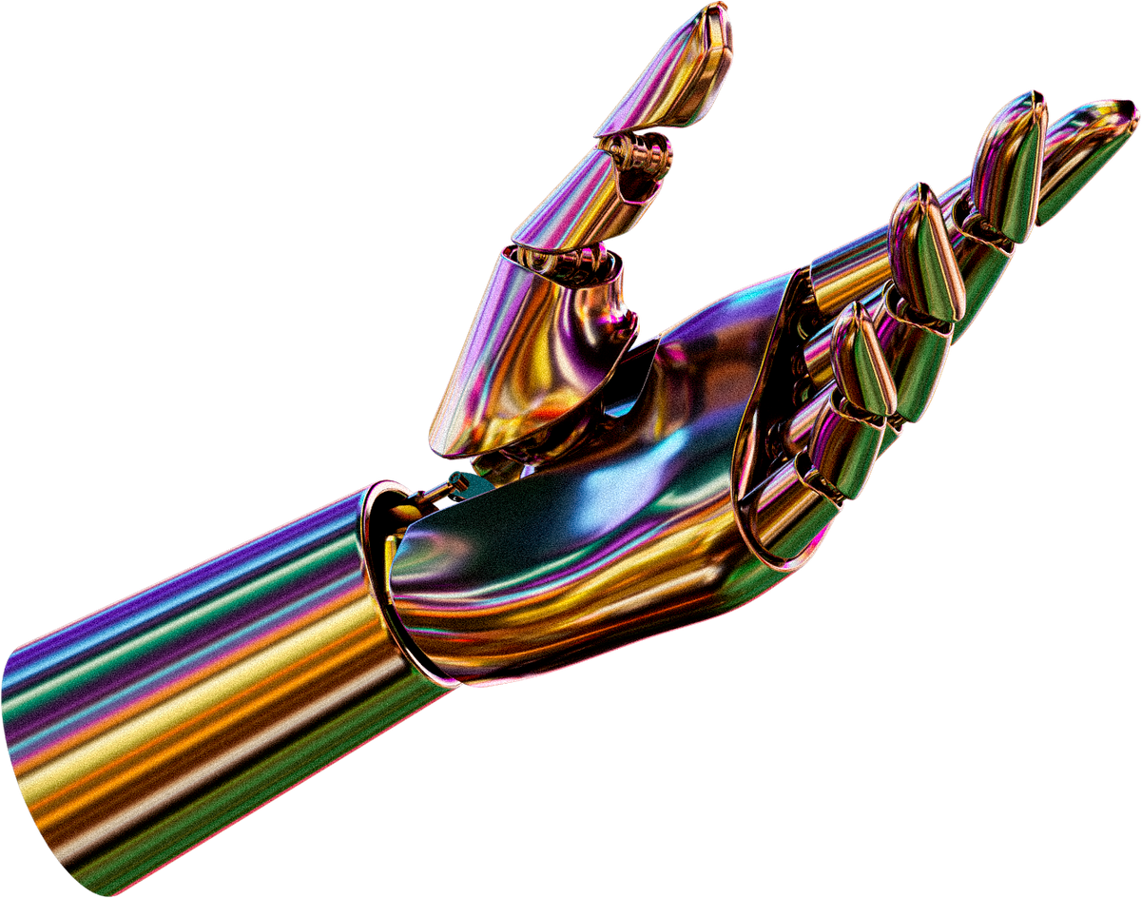
Timmerman Industries
Home
About
Contact
Thank You
FOR YOUR ATTENTION
Project URL : https://github.com/Ahmed164530/Game_Project

